Slide 1
Provided by

Slide 2
MyEverythingDiSC is a personalized learning experience that allows you to gain deeper insights about DiSC® and the people you know–anytime, from any device.

Slide 3
Meet Kari!
She’s about to experience MyEverythingDiSC for the first time.

Slide 4
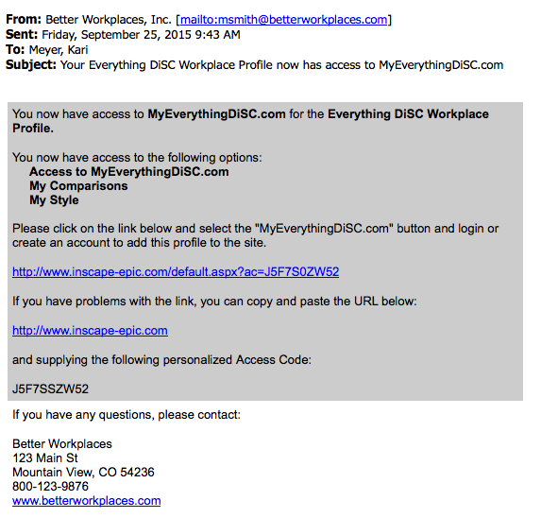
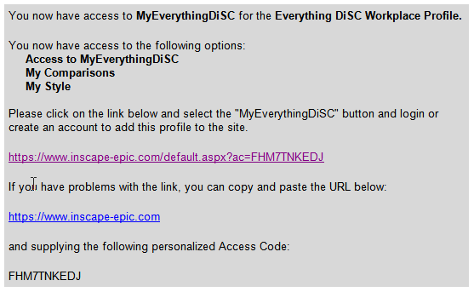
She’s invited to join.
Kari received an email with a link to MyEverythingDiSC after she took an Everything DiSC® assessment.
She follows the link in the email. (It contains her personalized access code.)

Slide 5
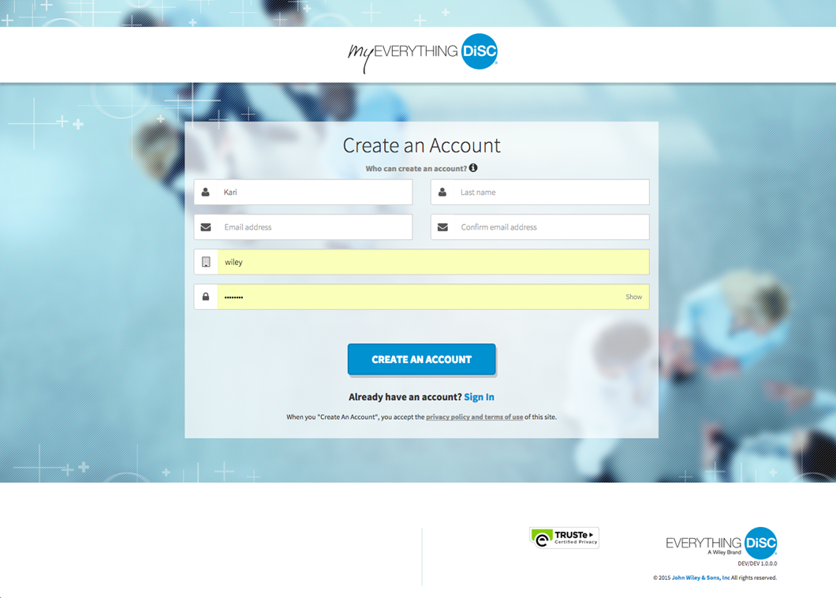
Kari creates an account.

Slide 6
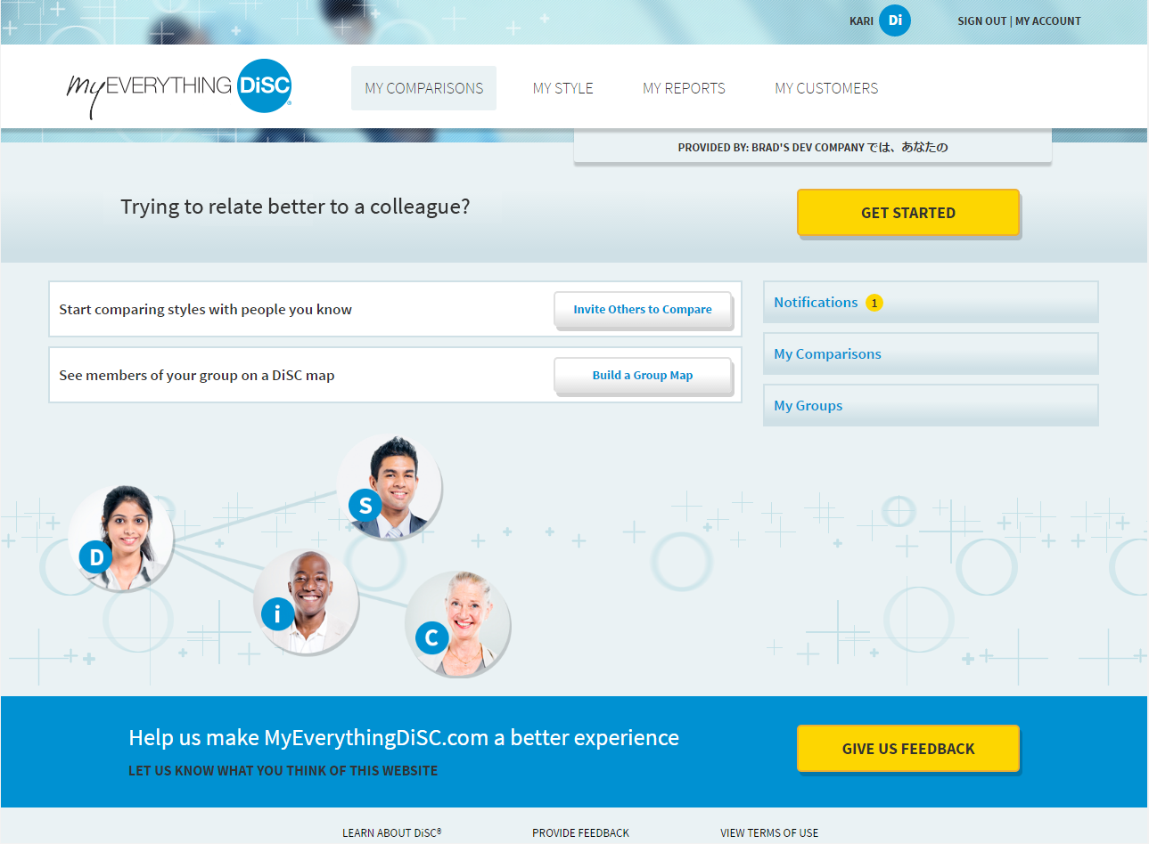
Kari is curious about her new teammates, and decides to Compare styles with them in My Comparisons.

Slide 7
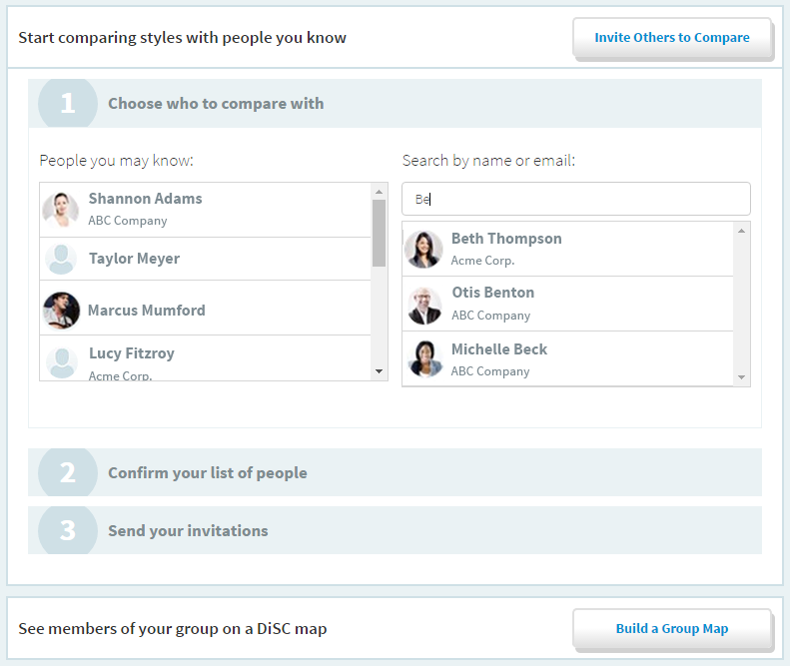
She begins by clicking Invite Others to Compare and searches for people to compare with.

Slide 8
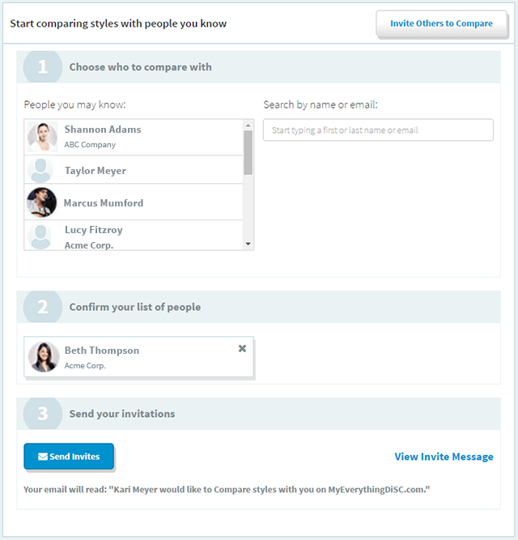
After she selects people, she sends invitations to compare.

Slide 9
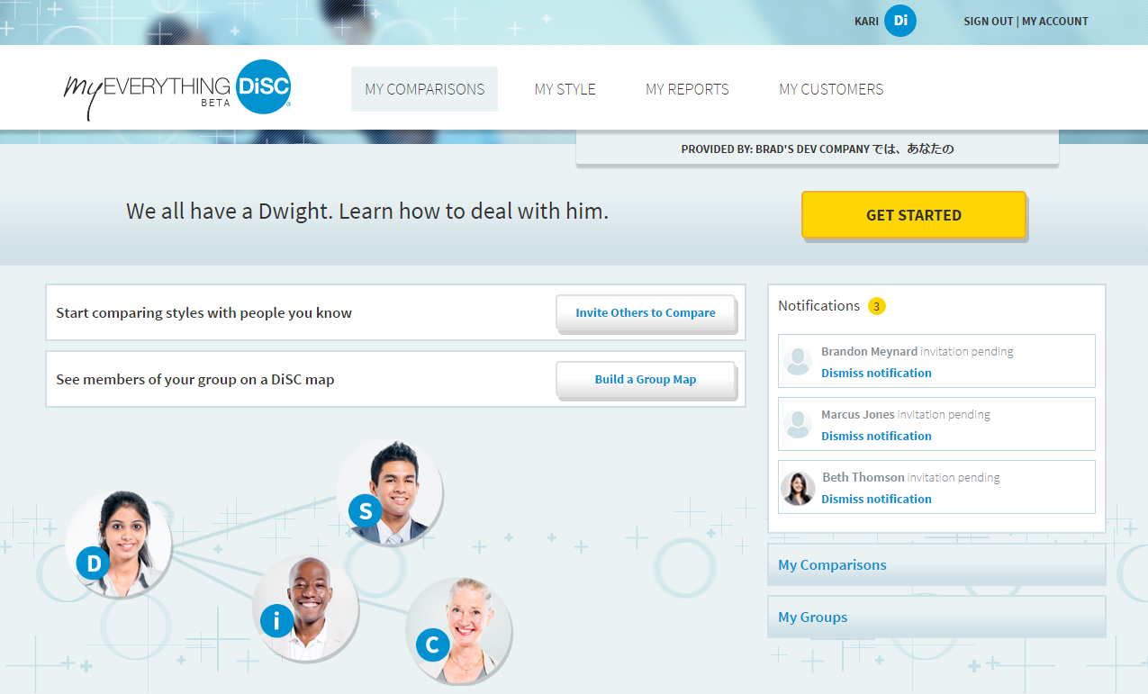
Kari sees who has accepted her invites to Compare and the invites she receives from others in the Notifications area.

Slide 10
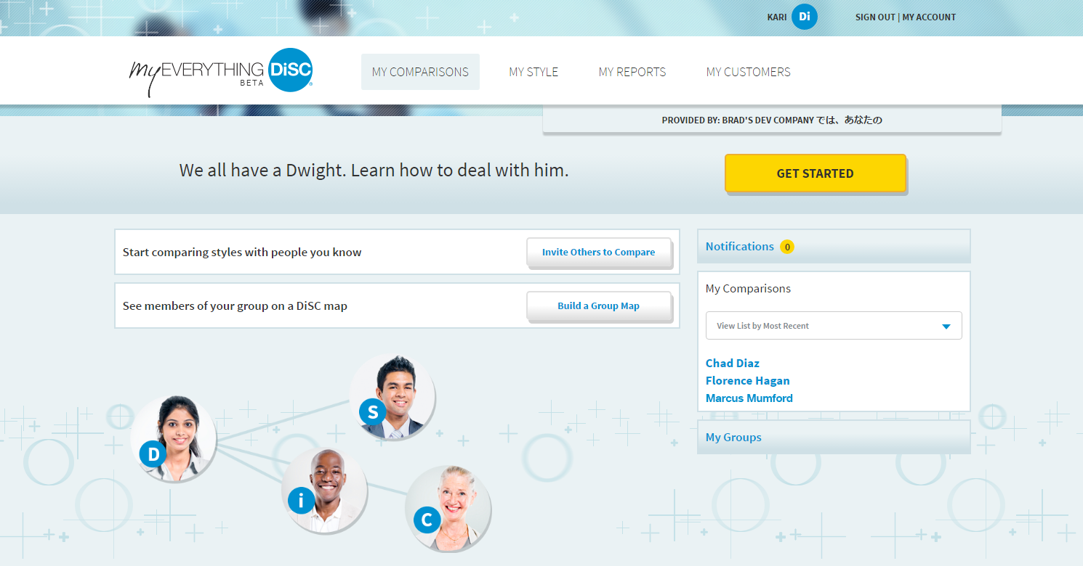
Once she accepts an invite or when someone accepts her invite to Compare, they appear in My Comparisons.

Slide 11
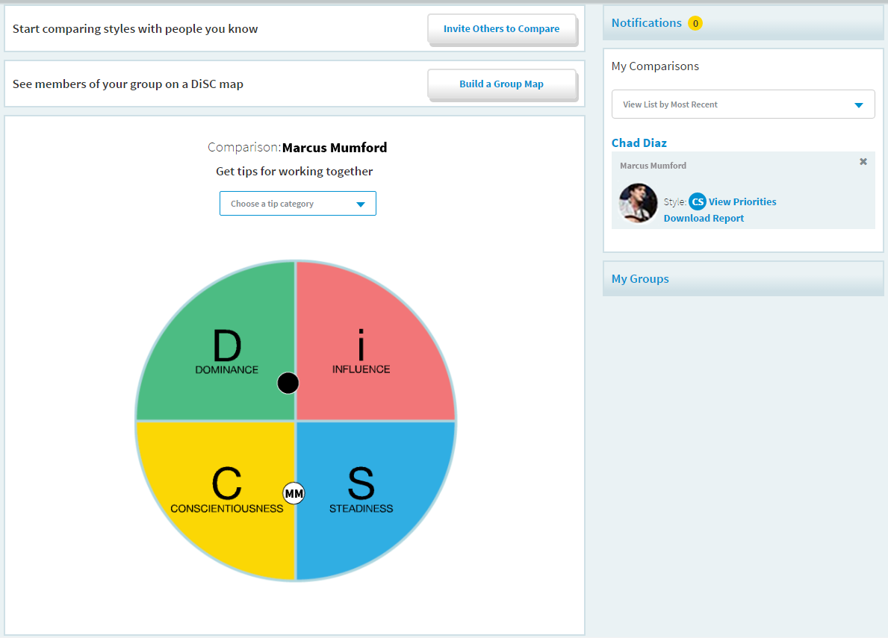
Kari clicks on a name to see a person’s DiSC® style, view their Priorities, and view or download a Comparison Report.

Slide 12
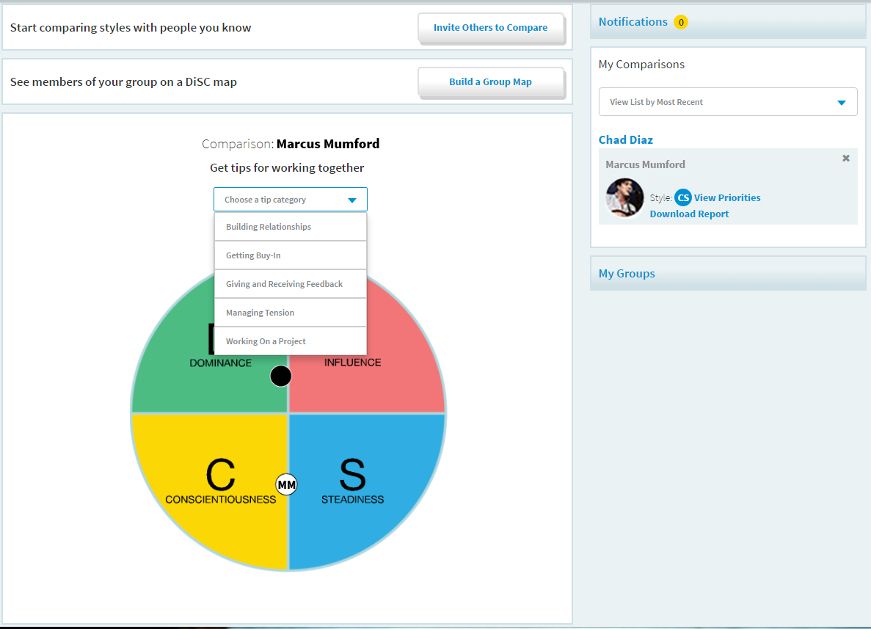
Kari sees her Comparison with Marcus. She chooses a tip category to learn more about working with him.

Slide 13
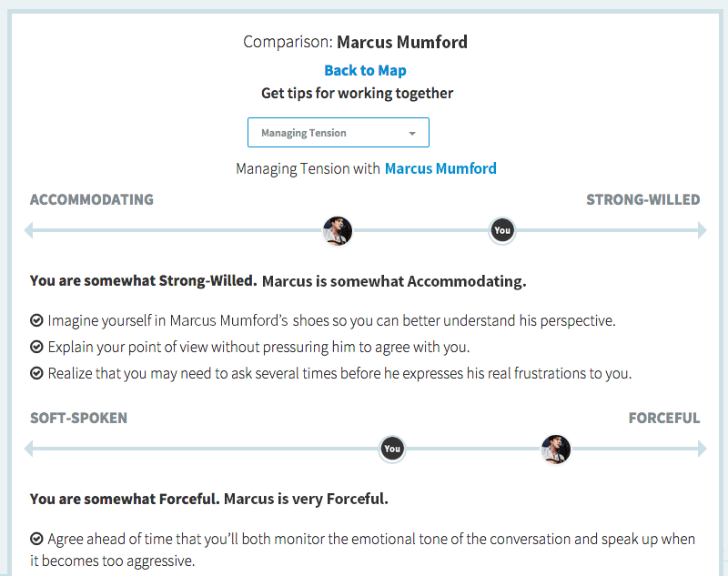
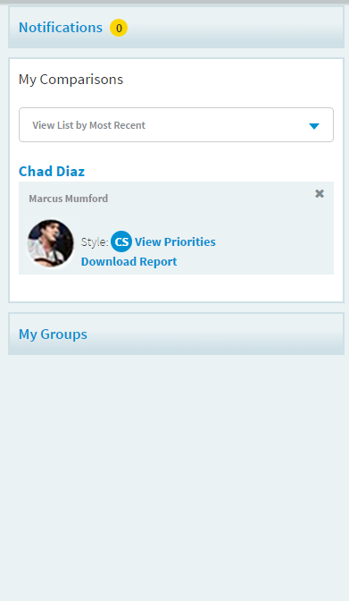
After selecting a topic, Kari sees herself and Marcus on a continua–along with practical tips.

Slide 14
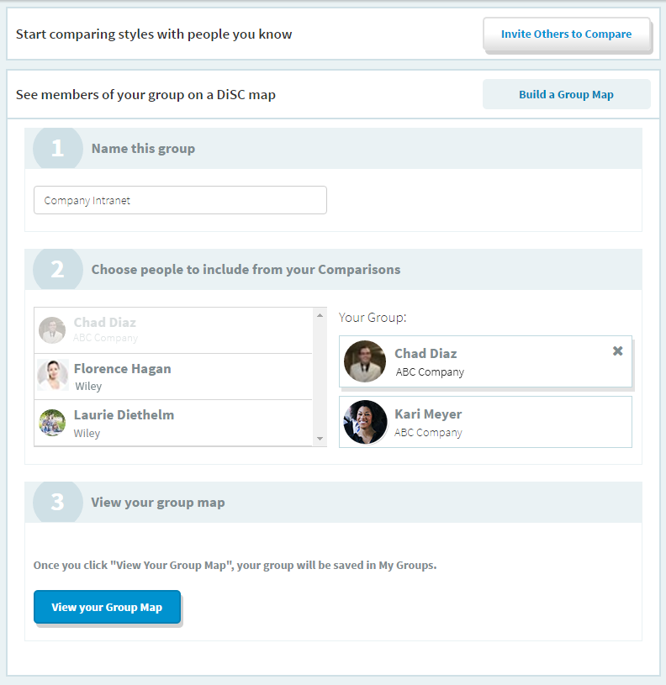
Kari wants to create a Group Map with her project team, so she builds one in 3 steps.

Slide 15
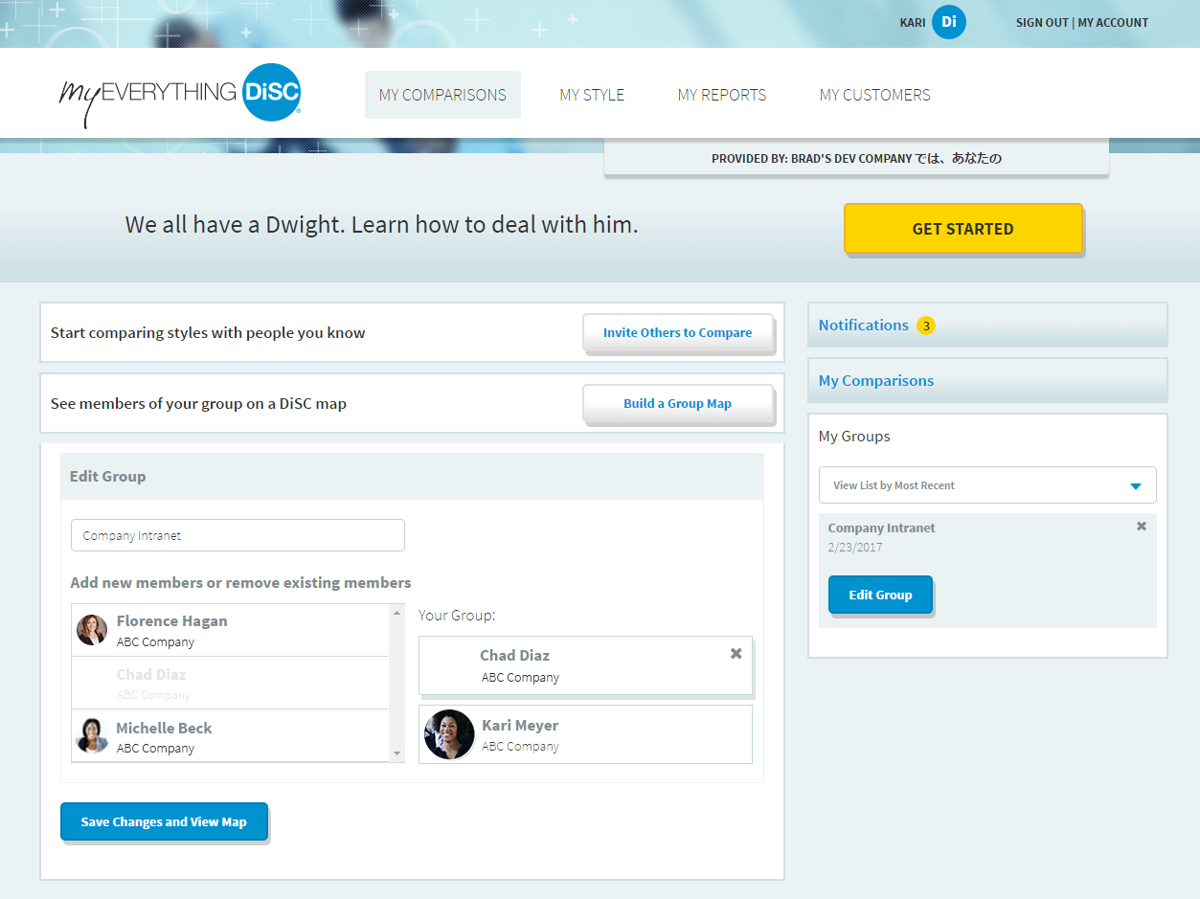
Kari’s group is saved and can be edited through My Groups.

Slide 16
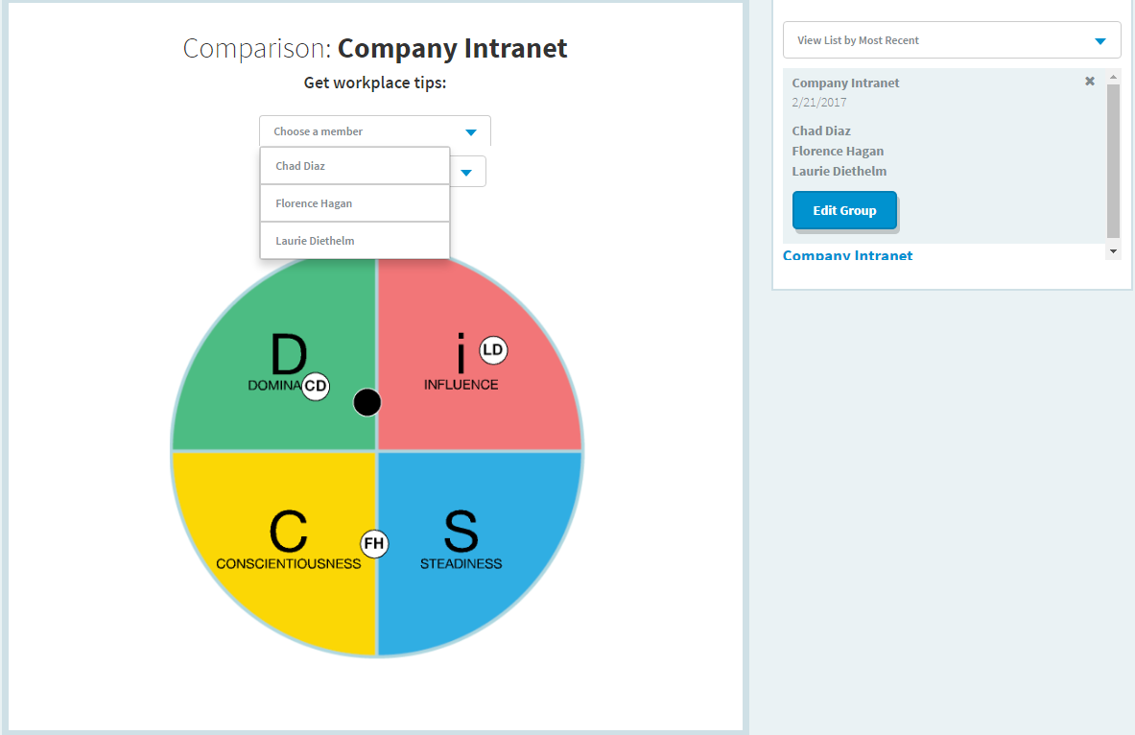
She views the Group Map and sees where all group members land on a DiSC® map. She chooses a member to get tips.

Slide 17
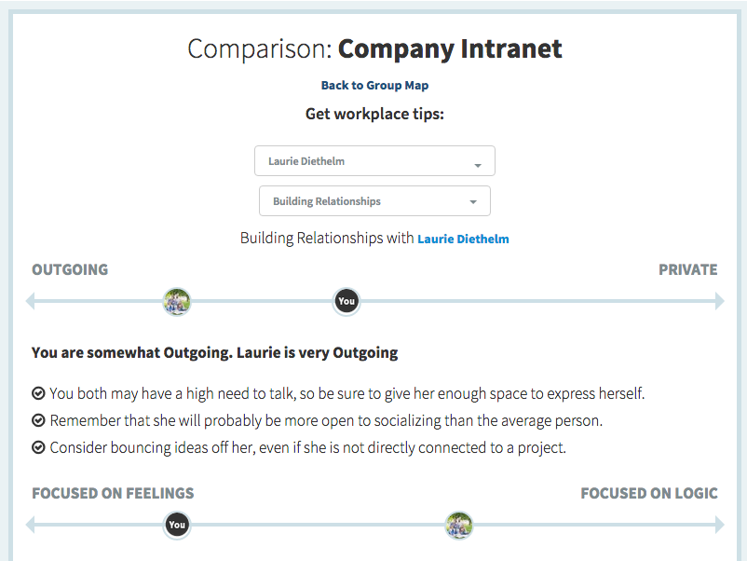
She sees where she and her teammate land on the continua. She can toggle between group members and tips.

Slide 18
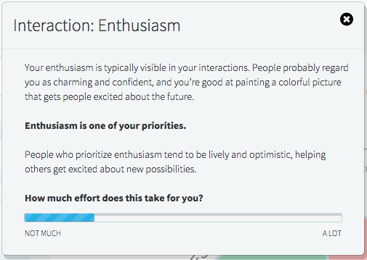
Kari wants to learn more about her style, so she goes to My Style, where she explores her DiSC® map and preferences.

Slide 19
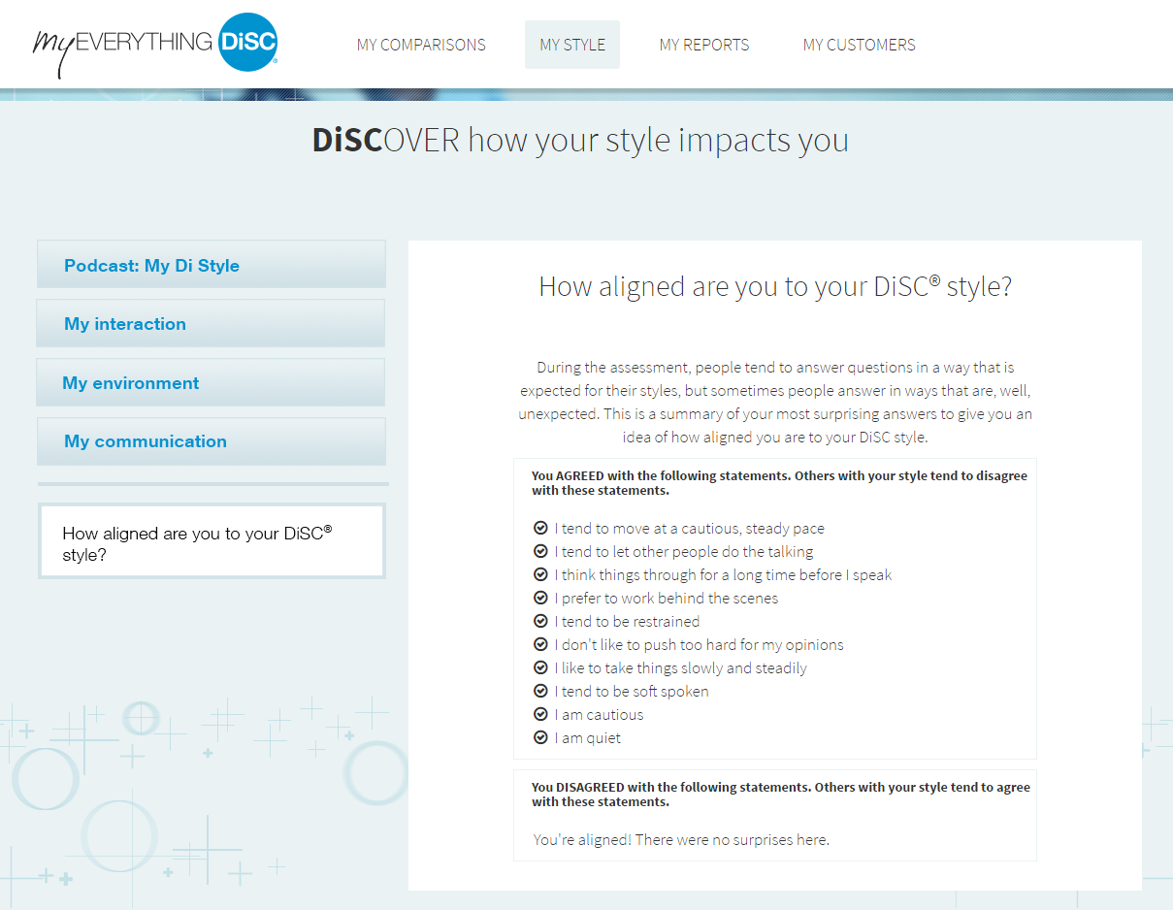
And sees how she’s unique.

Slide 20
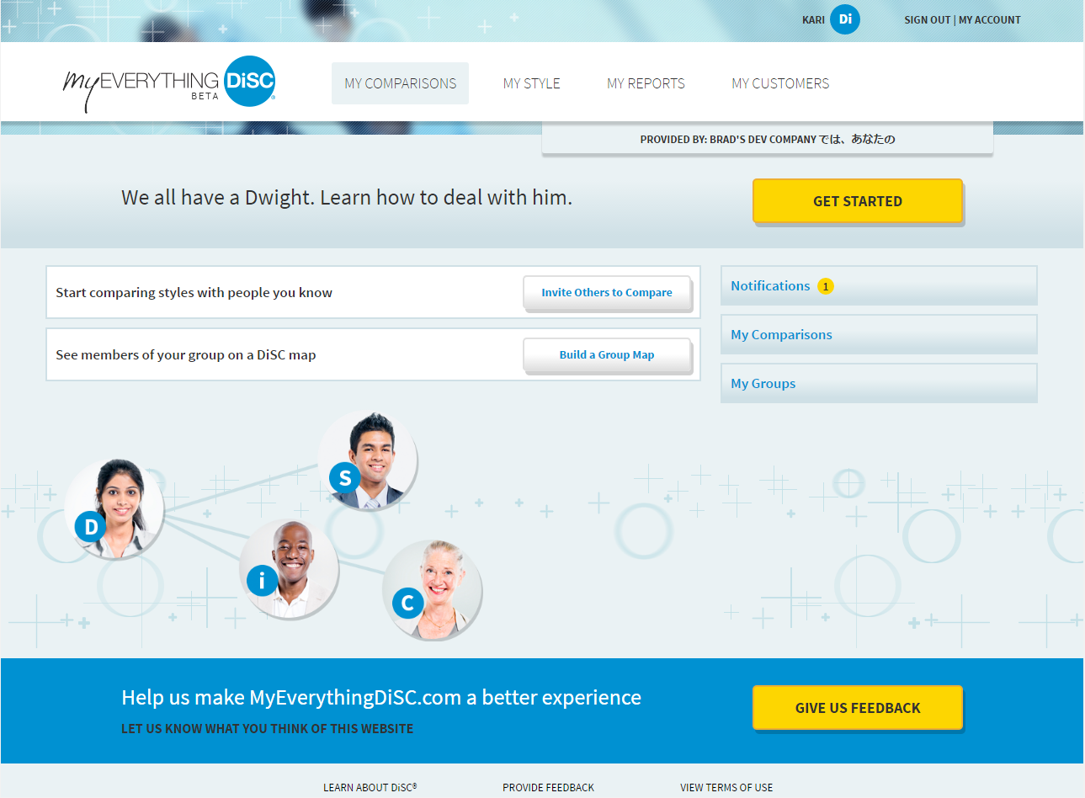
Intrigued by what she learns in My Style, Kari now wants to see her complete report.

Slide 21
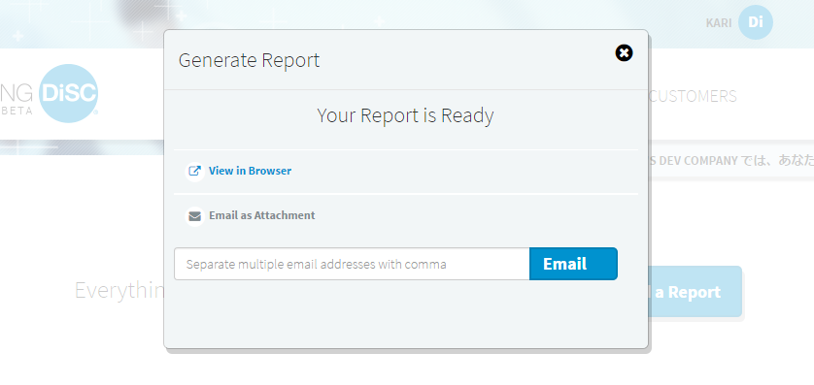
Kari selects the report from her My Reports list. She can view and download it, or email it as a PDF.

Slide 22
Kari wants to set up her preferences, so she goes to My Account.

Slide 23
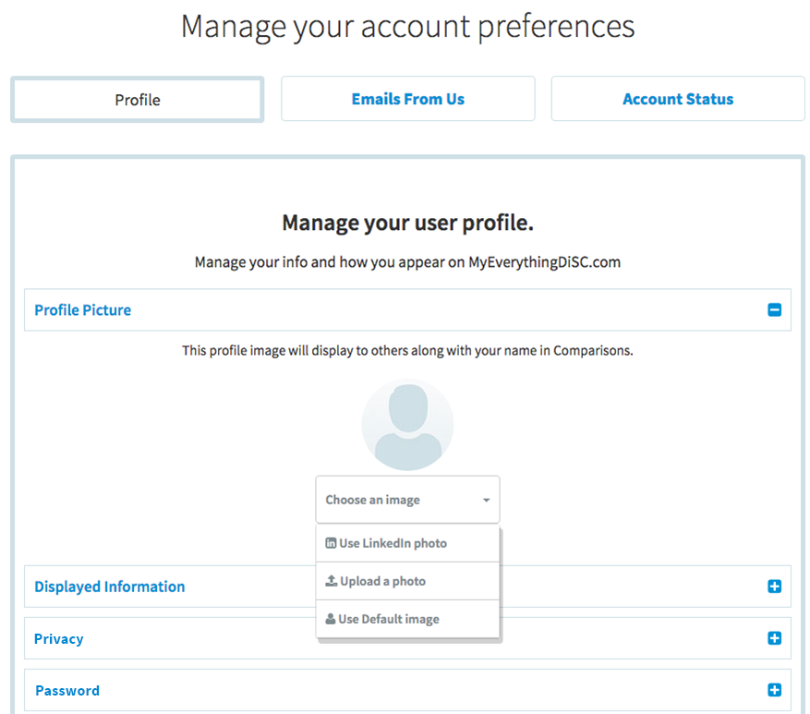
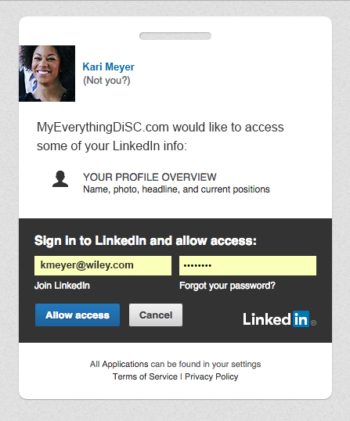
Her photo and information is visible to others using the site. Kari decides to use her LinkedIn photo.

Slide 24
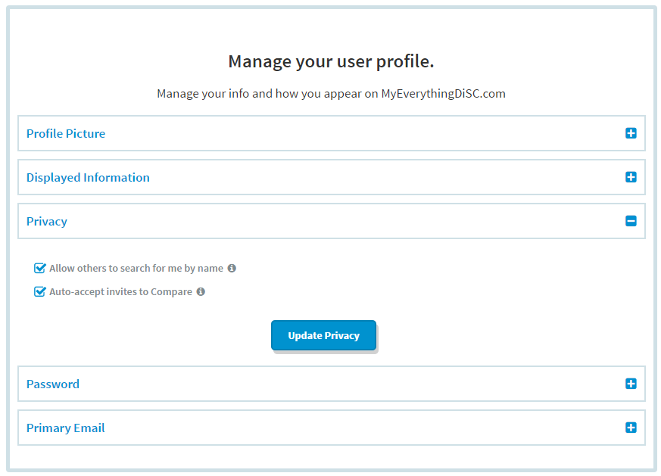
Kari makes sure her name and other information is set to display the way she wants.

Slide 25
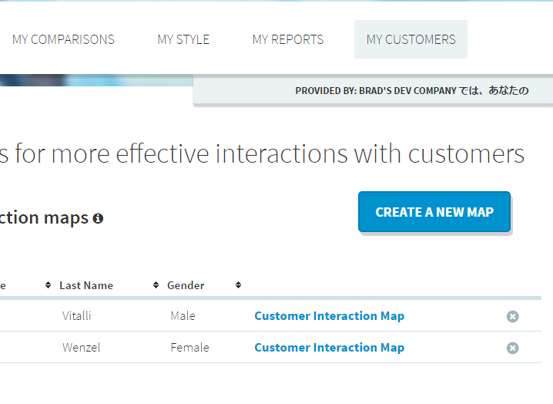
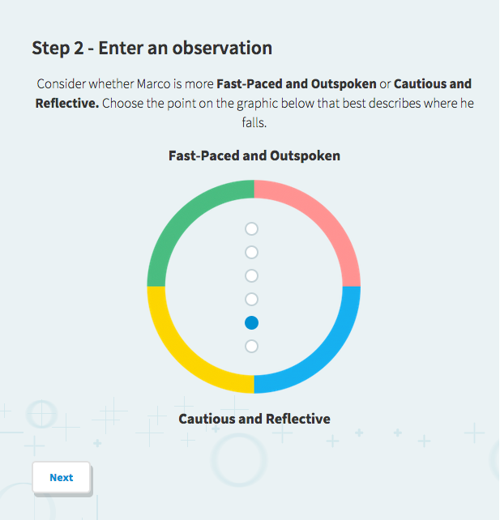
Next, Kari wants to create a Customer Sales Map (she’s also an Everything DiSC® Sales learner), so she goes to My Customers.
She creates a new map in 3 easy steps. All her Customer Sales Maps are saved here.

Slide 26
When she’s ready to know more about Everything DiSC®, Kari visits Learn About DiSC.

Slide 27
In Learn About DiSC®, Kari explores some of the learning tools.

Slide 28
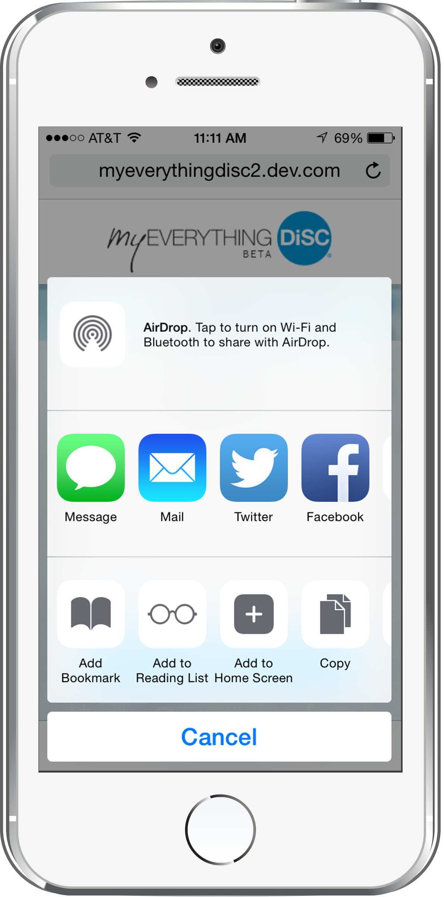
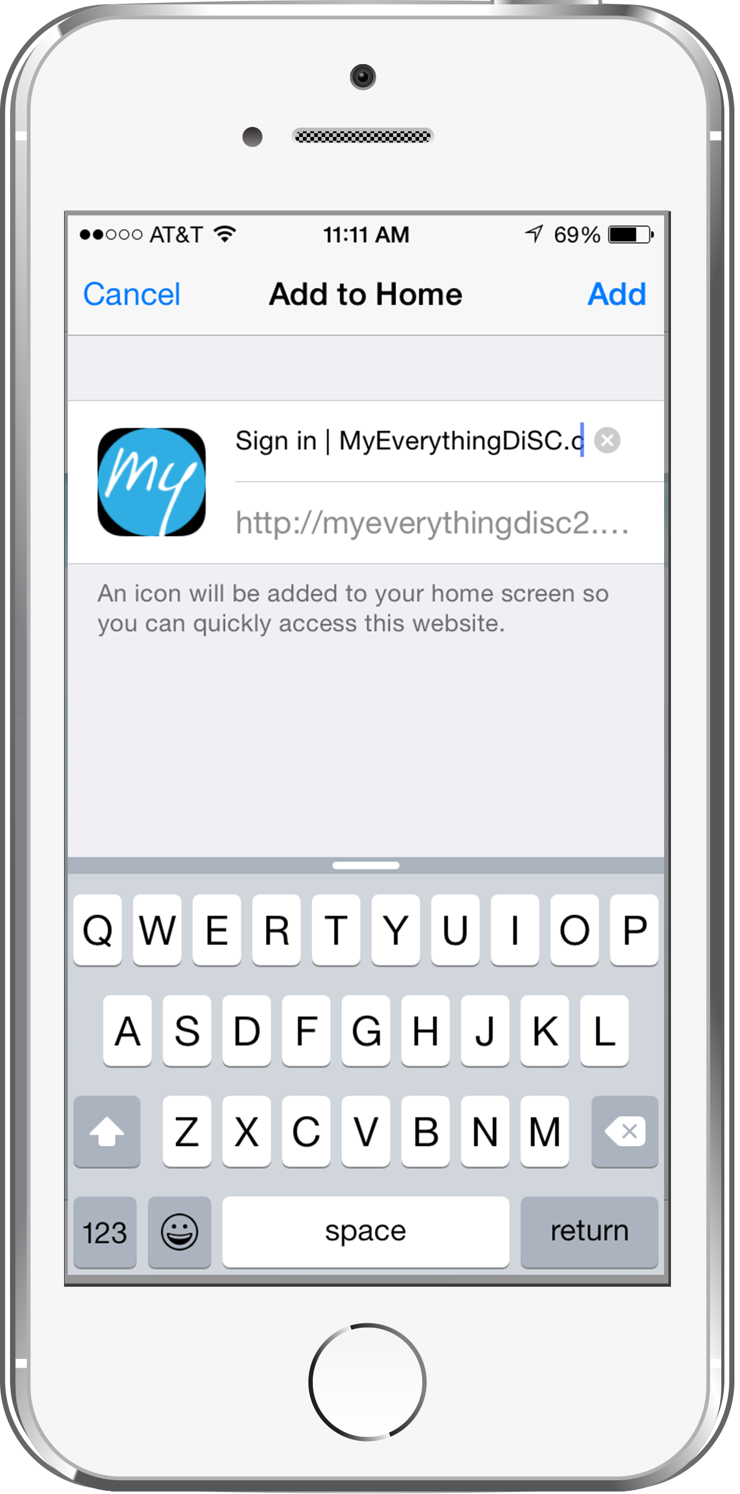
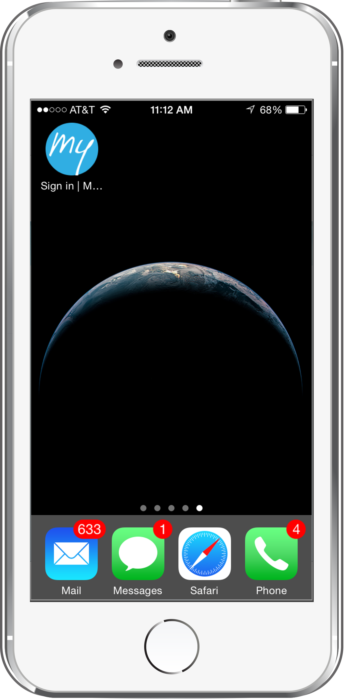
Knowing it will be handy on the go, Kari adds MyEverythingDiSC to her iPhone home screen.
1
2
3
.com
. . .

Slide 29
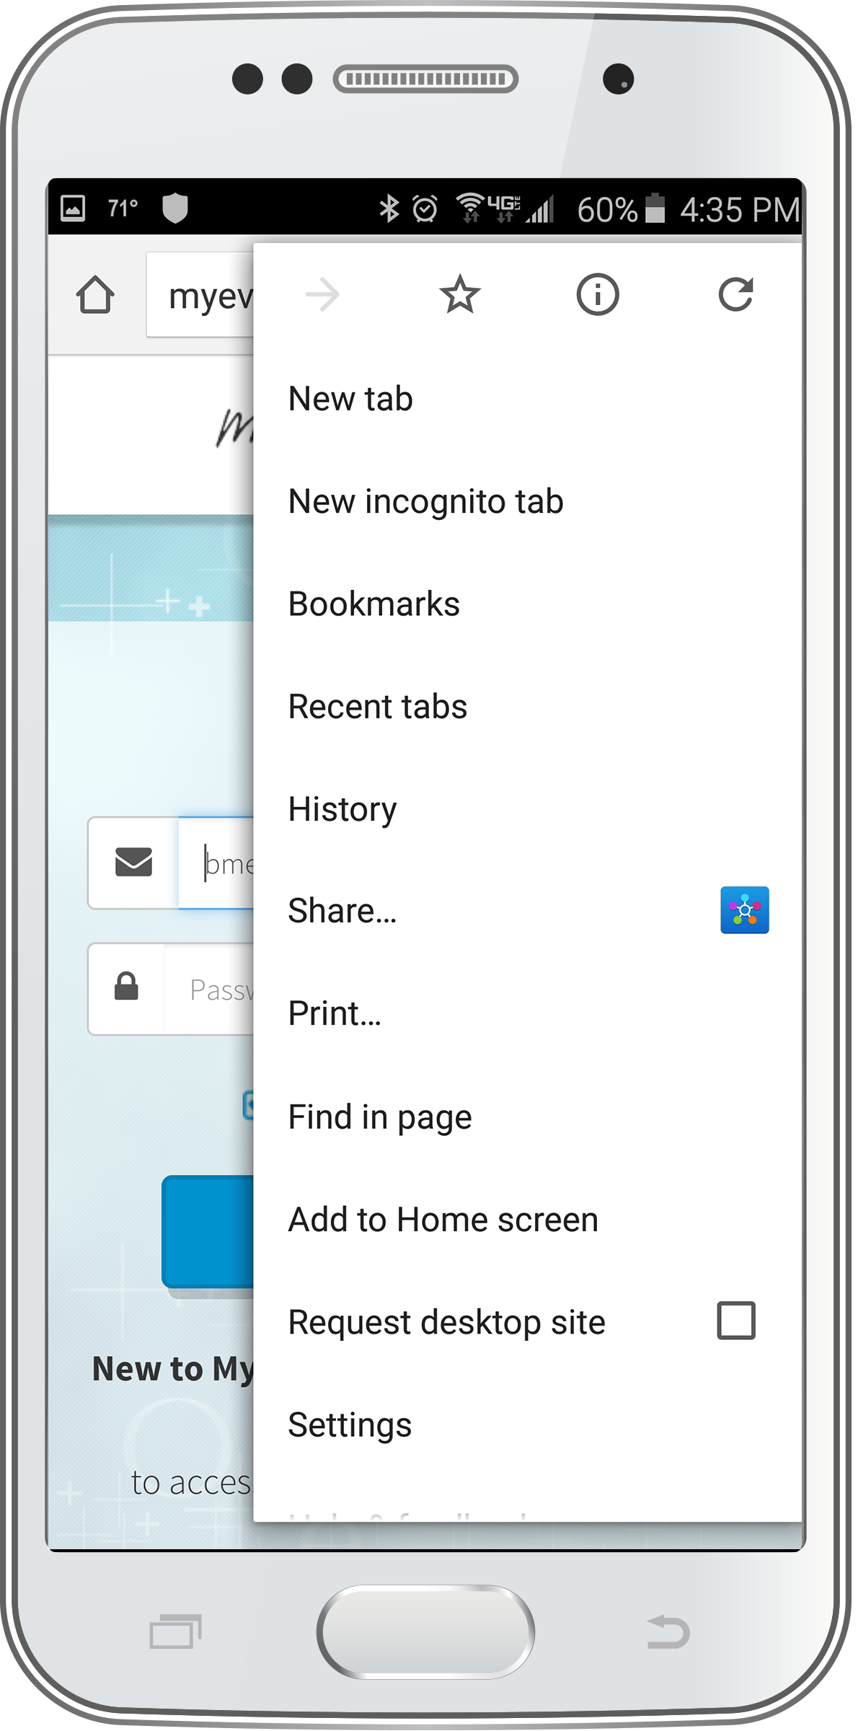
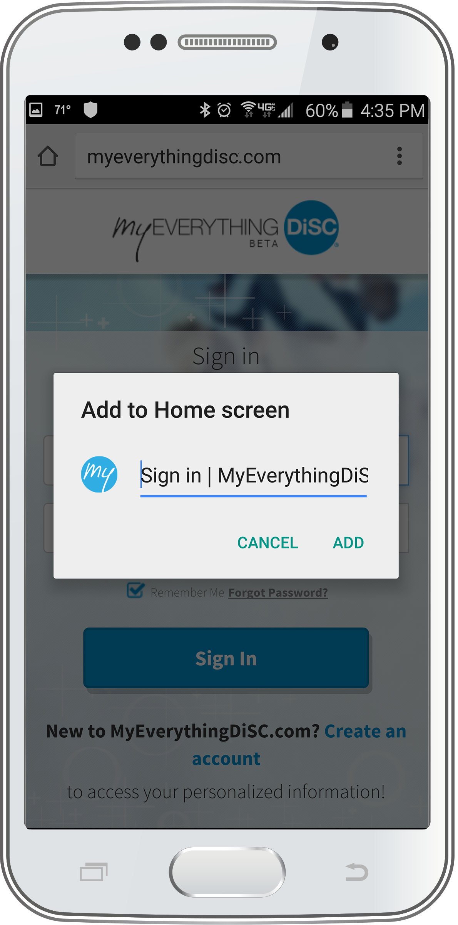
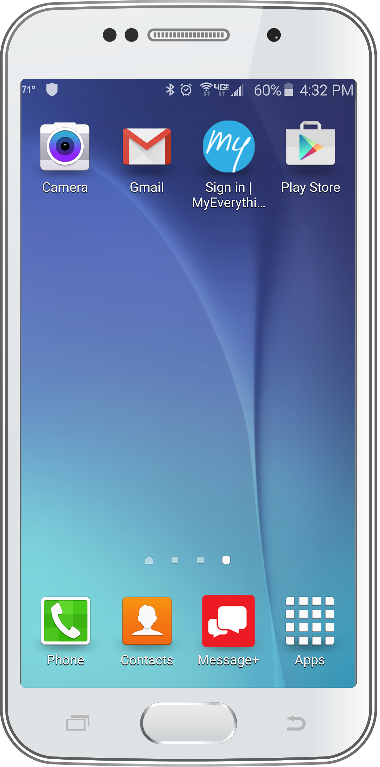
And her coworkers with Android phones can bookmark the site, too.
1
2
3

Slide 30
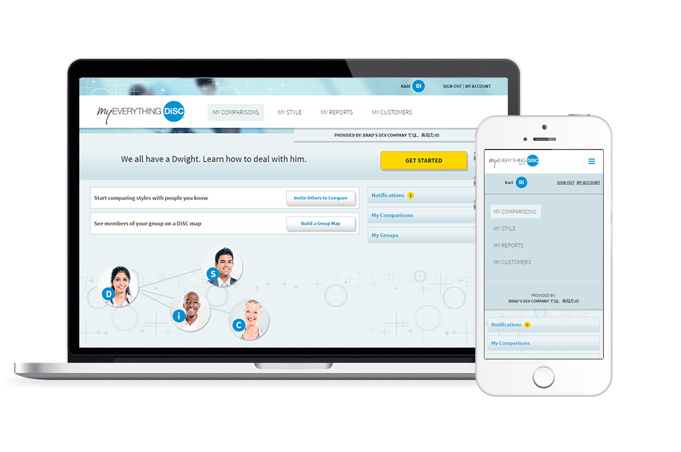
MyEverythingDiSC puts DiSC® learning into daily practice. Create an account today!

